Slide 1
Online text classifier for classifying news articles.
Himanshu Nirmal
Sachin Mohan Sujir

Slide 2
Index
Introduction
Motivation
System Architecture
Working
Bag of Words (BoW)
Dataset
Naïve Bayes classifier
System
Performance metrics
Future Scope
References

Slide 3
INTRODUCTION
1
Web based classifier
Predicts category of the given news headline
7 pre-defined categories

Slide 4
MOTIVATION
To give out correct information to users by accurately classifying news article and headline.
To aid user understand what category of news they’re reading and also provide some relevant links to their category so that user can dig deep and find out more.

Slide 5
SYSTEM ARCHITECTURE
A look at the functionality of the system.

Slide 6
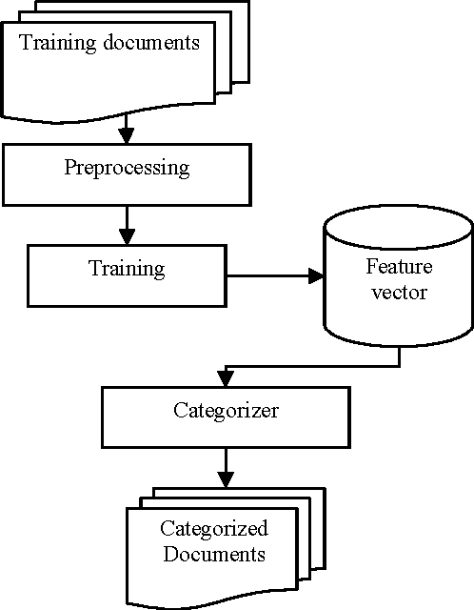

Slide 7
Working
Raw data text
Case conversion
Stop words
Tokenization
BoW
Class probability calculated & assigned

Slide 8
Bag of Words BoW
WASHINGTON —
President Trump glanced around
the room and noticed Lt. Gen. H.R.
McMaster, then his national
security advisor, with his head bent
over a notebook, scribbling
something down.

Slide 9
Bag of Words BoW
WASHINGTON —
President Trump glanced around
the room and noticed Lt. Gen. H.R.
McMaster, then his national
security advisor, with his
head bent over notebook,
scribbling something down.

Slide 10
BoW representation
President | 1
Trump | 1
National | 1
Security | 1
advisor | 1
... | ...

Slide 11
Dataset
https://www.kaggle.com/rmisra/news-category-dataset
https://www.kaggle.com/snapcrack/all-the-news
News articles with their respective category
Irrelevant attributes- Date, time, number of comments etc.
42,000 records divided into 7 categories

Slide 12
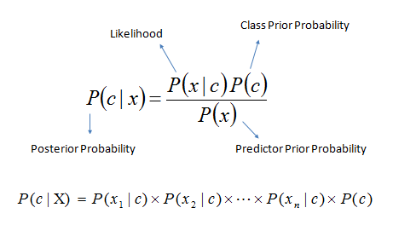
Naïve-Bayes Classifier
Probabilistic classification algorithm.
Uses probability to make predictions for the purpose of classification.
Used in binary as well as multi-class classification

Slide 13
Naïve-Bayes Classifier: Assumptions
Bag of Words assumption: Assume position doesn’t matter
Conditional Independence: Assume the feature probabilities P(x_{i}|c_{j}) are independent given the class c.

Slide 14

System
WEB BROWSER
Built using Python flask.
Input text headline to be predicted.

Slide 15

System
WEB BROWSER
News headline categorized hyperlink

Slide 16
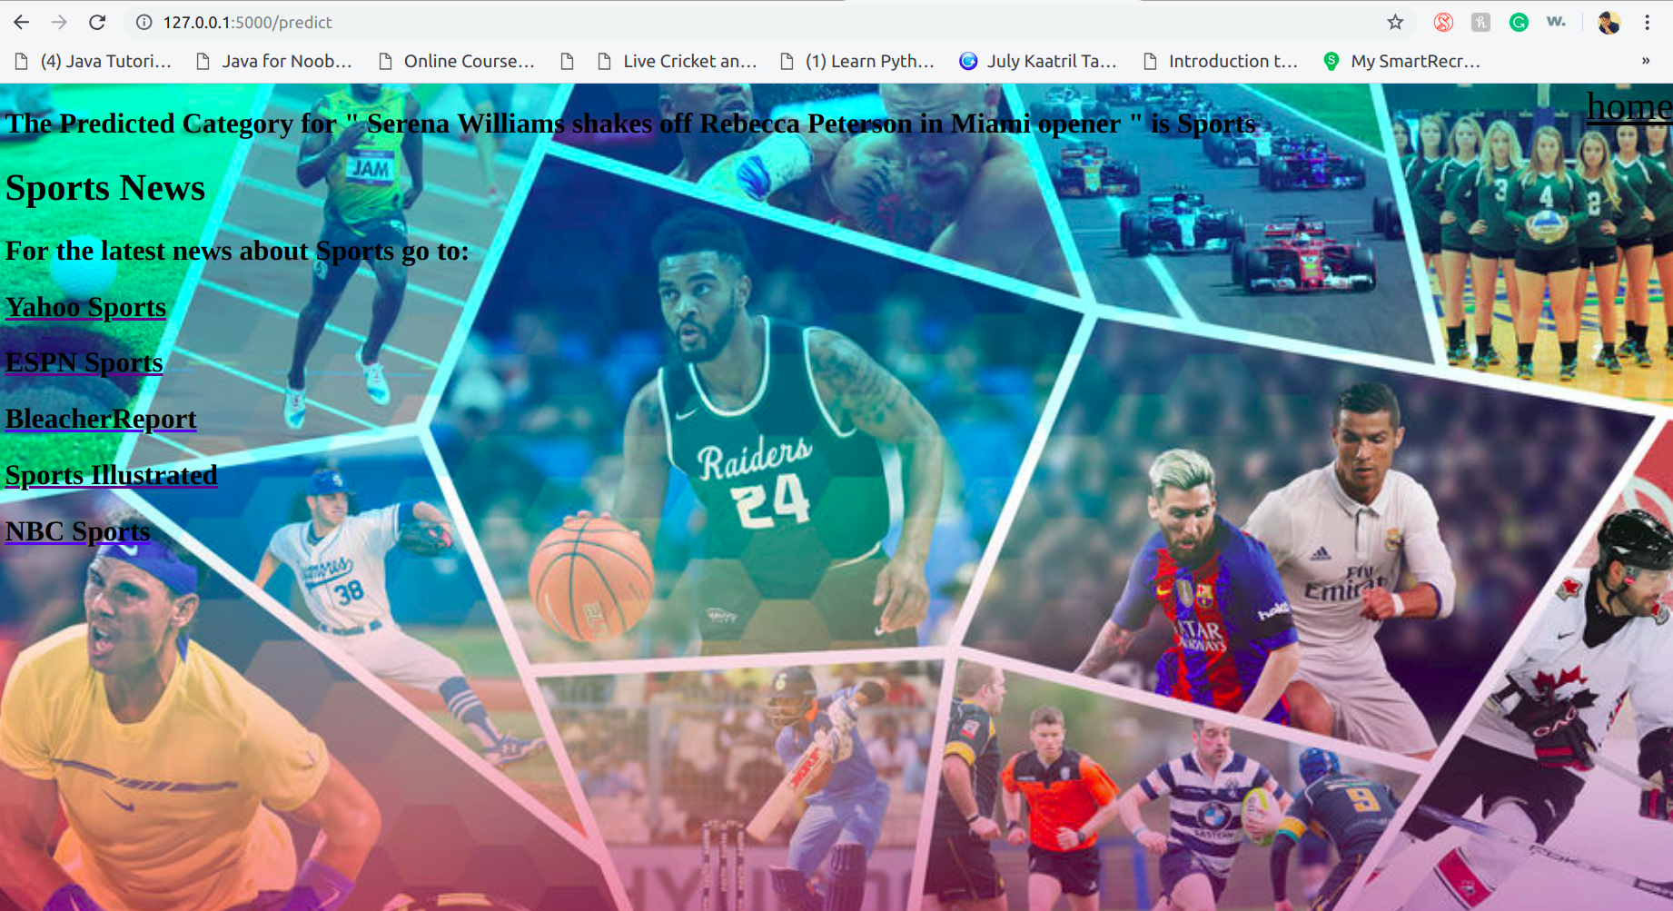
System
WEB BROWSER
News headline categorized hyperlink

Slide 17
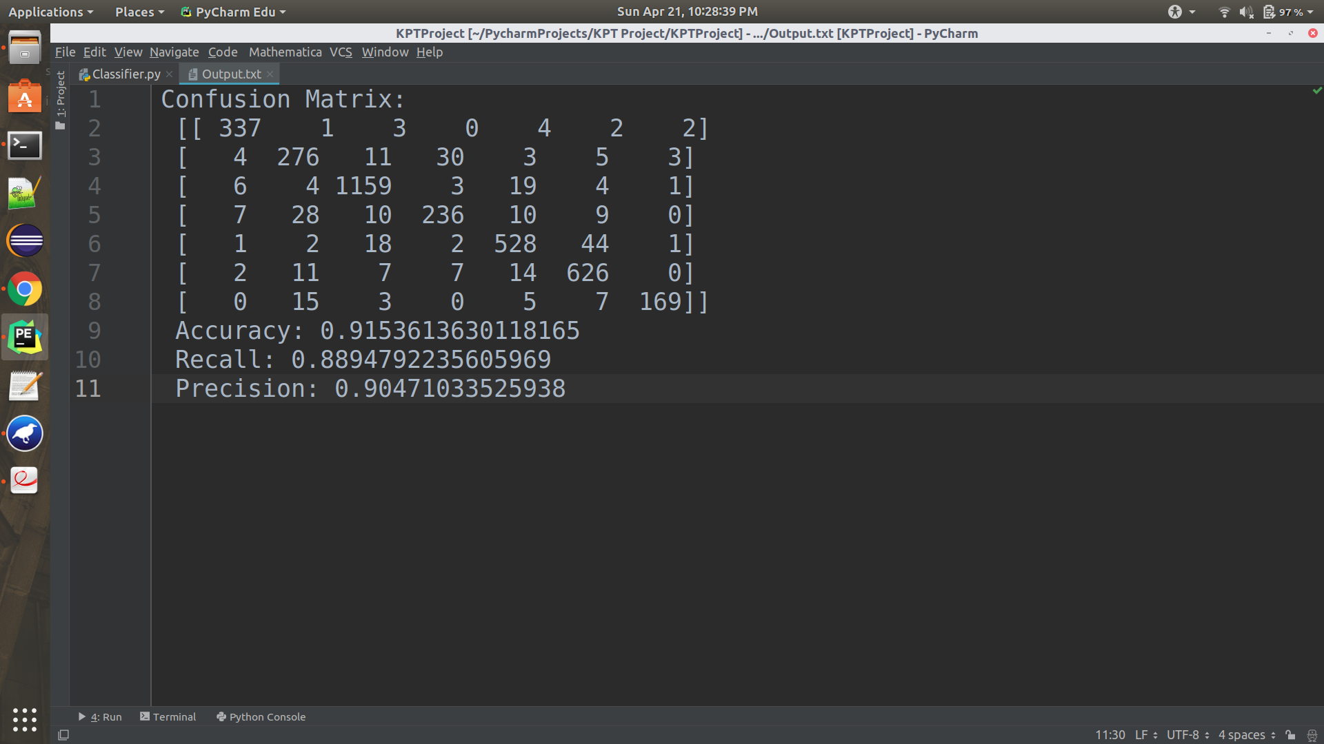
Performance metric

Slide 18
Issues
Imbalanced dataset
Model overfitting
Web integration

Slide 19
Future scope
News API can be integrated to show the category as well as its current events.
Can be used as an informative application.
More categories can be added to make the system more versatile.
More training data so that model can be trained & becomes more accurate.

Slide 20
References
https://ink.library.smu.edu.sg/cgi/viewcontent.cgi?article=1912&context=sis_research
https://www.semanticscholar.org/paper/Naive-Bayes-Classifier-based-Arabic-document-Noaman-Elmougy/7a201dbf8ea6a16b6cc93dca01b62c961aaea13f
https://towardsdatascience.com/implementing-a-naive-bayes-classifier-for-text-categorization-in-five-steps-f9192cdd54c3

Slide 21
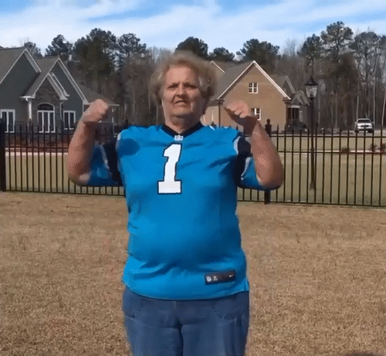
THANK YOU!

